Slide 1
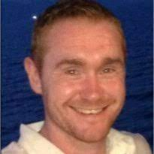
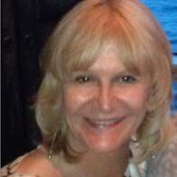
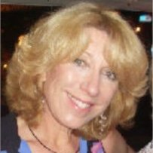
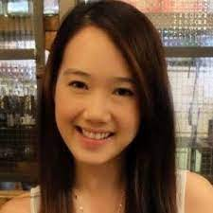
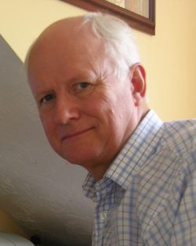
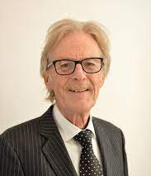
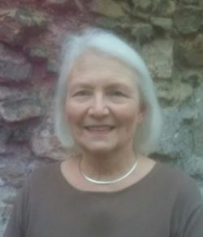
Introducing Our Trustee’s
Ryan Buglass
Penny Graver
Lynne Dexter​
Michelle Chung
Joint Chair of Trustee’s
Joint Chair of Trustee’s
Trustee
Trustee
Brian joscelyne
Roger dixon
Catherine Porter
Beryl riley
Trustee
Trustee
Trustee
Trustee

